Slide 1
Английский язык 5 класс УМК «Английский в фокусе» Module 9. Lesson 9b "It was great!”
Презентацию подготовила
учитель английского языка
ГБОУ СОШ №252
Копьева Екатерина Александровна

Slide 2
Our plan
check your homework;
remember some grammar rules;
do some lexical and grammar exercises.

Slide 3
to be in the Past Simple Tense
was were

Slide 4
p.107 ex3
1. There ……….. a lot of people in the fast food restaurant last night. It was very busy! 2. ……….. Katie at school last week? No, she ………... She was sick. 3. These flowers are beautiful. ……….. they expensive? No, they ……….. . 4. ……….. James and Charlotte in the florist’s?
Yes, they ……….. . 5. That’s a pretty dress. ……….. it in the sale? Yes, it ……….. . 6. ……….. there a toy shop in that shopping centre? No, there ……….. . 7. Where ……….. you yesterday, Sam? I ……….. at the zoo with my mum. 8. We ……….. at home last night. We ……….. at the cinema with friends.

Slide 5
1. There were a lot of people in the fast food restaurant last night. It was very busy! 2. Was Katie at school last week? No, she wasn’t. She was sick. 3. These flowers are beautiful. Were they expensive? No, they weren’t. 4. Were James and Charlotte in the florist’s? Yes, they were. 5. That’s a pretty dress. Was it in the sale? Yes, it was. 6. Was there a toy shop in that shopping centre? No, there wasn’t. 7. Where were you yesterday, Sam? I was at the zoo with my mum. 8. We weren’t at home last night. We were at the cinema with friends.

Slide 7
to advertise [ˈædvərtaɪz]
an advertisement [ədˈvɜːtɪsmənt]
an advertiser [ˈædvətaɪzər]
*transcription by Cambridge Dictionary

Slide 8
April, the 19th Classwork
to advertise [ˈædvərtaɪz] рекламировать
an advertisement [ədˈvɜː.tɪs.mənt] реклама
an advertiser [ˈæd.və.taɪ.zər] рекламодатель
*transcription by Cambridge Dictionary

Slide 10
The Past Simple Tense
(Прошедшее простое время)
Используем, когда говорим о действии, которое произошло в прошлом.
V2/ed

Slide 12
+ I played football yesterday.
- I didn’t play_ football yesterday.
? Did you play_ football yesterday?

Slide 13
Маркеры (слова-спутники):
last (week, month, year) – прошлый год
yesterday – вчера
ago (5 years ago) – 5 лет назад

Slide 15
ex.4
Fill in the verbs: walked, lived, reached, visited, watched, slipped, cried, travelled, painted, advertised, asked, decided, opened, washed, skated in the correct column
[t] | [d] | [ɪd]

Slide 16
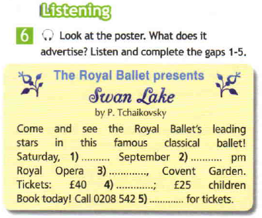

Slide 17
Check yourself
25th
8
House
adults
3859

Slide 18
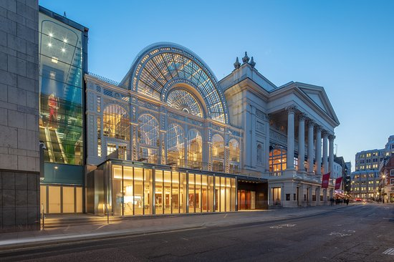
The Royal Opera House Covent Garden

Slide 19
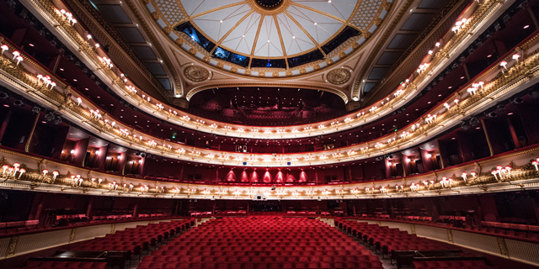
The Royal Opera House Covent Garden

Slide 20
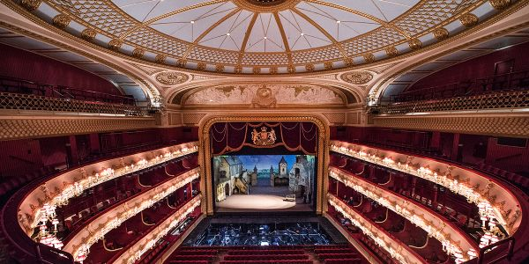
The Royal Opera House Covent Garden

Slide 21
Now you will watch the video and listen to an actress Lesley Sharp.
You have to hear her question, she will repeat it twice, then you will transform it to the Past Simple Tense.

Slide 22
Try to remember any film or series where you could see the actress.

Slide 23
Our plan
check => checked your homework;
remember => remembered some grammar rules;
do => did some lexical and grammar exercises.

Slide 24
Homework
p.109 ex.3,5

